Slide 1

TECHNICAL EDUCATION
Networking
Fundamentals
From ARPANET to Modern Internet Architecture
Protocol Stack
Evolution
Session 2
TCP/IP & OSI
1957 - Present
Comprehensive Notes

Slide 2
01
What is the Internet?
Global Network Definition
Network Communication Flow
The Internet is a global network of interconnected computers and devices that communicate using standardized protocols like TCP/IP to share information and resources across vast distances.
Key Insight: Think of it as a "network of networks" where machines exchange data seamlessly over long distances.
Computer 1
Computer 4
Core Characteristics
Data travels through multiple routers to reach its destination
Standardized Protocols
Resource Sharing
TCP/IP ensures universal communication
Data, files, and services distributed globally
Decentralized Structure
Scalable Architecture
No single point of control or failure
Billions of devices can connect simultaneously
Broader Context
Network Concept: A network is any group of interconnected items. Social media connections, transportation systems, and communication channels all form networks.

Slide 3
02
The Beginning: Cold War & Sputnik
October 4, 1957
February 7, 1958
Sputnik Shock
ARPA Formation
The Soviet Union launched Sputnik, the world's first artificial satellite. This tiny 58cm metal sphere triggered a technological awakening in the United States.
The U.S. formed ARPA (Advanced Research Projects Agency) to fund cutting-edge research and ensure America wouldn't fall behind technologically.
U.S. Response: "Wait, they're beating us in space?" — A massive push to invest in science and technology ensued.
Key Mission: Fund "crazy-cool research" — ambitious, high-risk ideas with transformative potential.
The Driving Force: Resilient Communications
Military Necessity
Decentralization Goal
Technological Leap
Create a communication network that wouldn't collapse if parts were destroyed in a nuclear attack
Design a system where no single point of failure could bring down the entire network
Push the boundaries of what was possible in computer networking and data transmission
Historical Context: Sputnik put fire under the U.S. to advance ideas. One of these ideas? A communication network that could survive potential nuclear attack. Not a pleasant thought, but that's the historical reality that drove innovation.

Slide 4
03
Early Challenges: Centralized Systems
Single Mainframe Problem
The Critical Need
Most institutions had one large mainframe computer — massive, expensive machines that filled entire rooms.
Communication systems were centralized — a single point of failure could bring down the entire network.
Resource Bottleneck: Users queued up to use the computer directly
Strategic Requirement
Batch Processing: Jobs submitted via punch cards, long wait times
A communications system that could survive or stay functional even if parts were destroyed in a potential nuclear attack.
High Cost: Limited access due to expensive hardware and maintenance
Decentralized architecture
Multiple redundant paths
Self-healing network topology
"Sneakernet" Era
Research Collaboration Need
Communication between computers was done physically — people literally carried tapes or punch cards from one location to another. This primitive method was jokingly called "sneakernet" .
Scientists needed to share resources and collaborate across institutions without physically transporting data. The stage was set for a revolutionary solution.

Slide 5
04
Visionaries: Licklider, Baran & Davies
JL
J.C.R. Licklider
PB
Paul Baran
DD
Donald Davies
ARPA Visionary
U.S. Researcher
UK Researcher
Daydreamed about a global network where people could "log in" to different computers remotely.
Pioneered the concept of packet switching in the United States, working on distributed networks for RAND Corporation.
Independently developed packet switching in the UK at the National Physical Laboratory around the same time.
Vision: "Intergalactic Computer Network" — a sci-fi inspired name for a revolutionary concept.
Contribution: Developed the theoretical foundation for resilient, distributed communication networks.
Impact: Coined the term "packet" and built one of the first packet-switched networks.
The Packet Switching Revolution
Core Innovation: Splitting data into small packets that can travel through a network along different routes.
The Breakthrough Idea
"What if we chop data into pieces instead of sending it as one continuous stream?" This approach turned out to be a big deal — the foundation of modern networking.
Dynamic Routing: If one route is blocked, packets take a detour
Resilience: Network stays functional even if parts are destroyed
Revolutionary Concept: Data fragmentation enables resilient, distributed communication
Global Impact: Simultaneous discovery in US and UK accelerated development

Slide 6
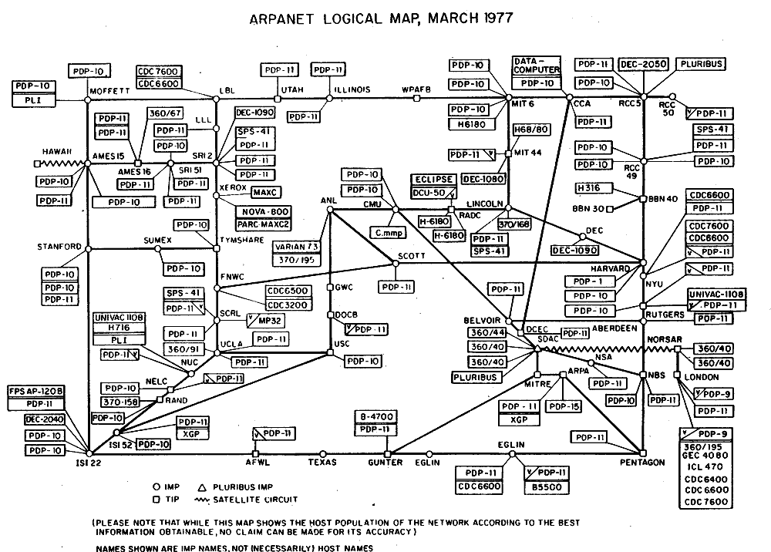
05
ARPANET: The First Experiment
1969
Initial Network Topology
ARPANET Launch
ARPA funded a groundbreaking project connecting four universities, creating the first packet-switched network.
UCLA
SRI
University of California, Los Angeles
Stanford Research Institute
UCSB
Utah
UC Santa Barbara
University of Utah
Four nodes connected in a pioneering configuration
October 29, 1969
The First Message: "lo"
The first message was sent from UCLA to SRI. They tried to type "login," but the system crashed after sending "lo".
What Was Tested
Packet Switching: Data broken into packets traveling different routes
So the very first message was basically "lo" — like saying "Hello" to the future.
Host-to-Host Protocol: NCP (Network Control Protocol) communication
Remote Access: Computers communicating over distance

Slide 7
06
TCP/IP: The Universal Language
Vint Cerf & Bob Kahn
January 1, 1983
"Fathers of the Internet"
Flag Day(internet birthday)
As different networks emerged, a critical question arose: "How do we get them all to talk to each other?"
ARPANET officially switched from NCP to TCP/IP. This date is considered the "birthday of the modern Internet" .
Cerf and Kahn developed TCP (Transmission Control Protocol) in the early 1970s, later splitting it into TCP + IP.
Significance: Everything now used the same "language" — universal protocol standardization.
TCP/IP Breakdown: Two Critical Functions
IP
Internet Protocol
TCP
Transmission Control
Function: Gives an "address" to every device and decides where packets should go.
Function: Makes sure data arrives correctly and in the right order.
Reliability: Ensures complete, accurate delivery
Addressing: Unique IP addresses for every device
Ordering: Reassembles packets in correct sequence
Routing: Determines packet paths across networks
Universal Standard
Commercial Era
Mass Adoption
All networks speak same language
Early '90s: ISPs emerged
Public access exploded

Slide 8
07
World Wide Web Revolution
1989-1990
1993
Tim Berners-Lee at CERN
Mosaic Browser
Working at CERN (Switzerland), Berners-Lee wanted a simpler way for scientists to share documents across the Internet.
Mosaic was the first graphical web browser, making the Web accessible to non-technical users.
Invention: The World Wide Web — a system of interlinked hypertext documents.
Clickable links
Image display
Visual interface
User-friendly
The Dot-Com Boom
Core Technologies Invented
Companies realized they could make money on the Internet → The mid-to-late '90s saw explosive growth.
HTML
HyperText Markup Language
The language for creating web pages and structuring content
HyperText Transfer Protocol
Result: By the end of the '90s, everyone was jumping online — creating websites, e-commerce, and digital services.
HTTP
The protocol for transferring web pages between servers and browsers
Hyperlinks
Clickable text connecting pages — "surfing" the web
Key Distinction: The Internet is the infrastructure (the "highway"). The Web is one major service running on top (the "cars"). Email, FTP, chat, etc., are other services.

Slide 9
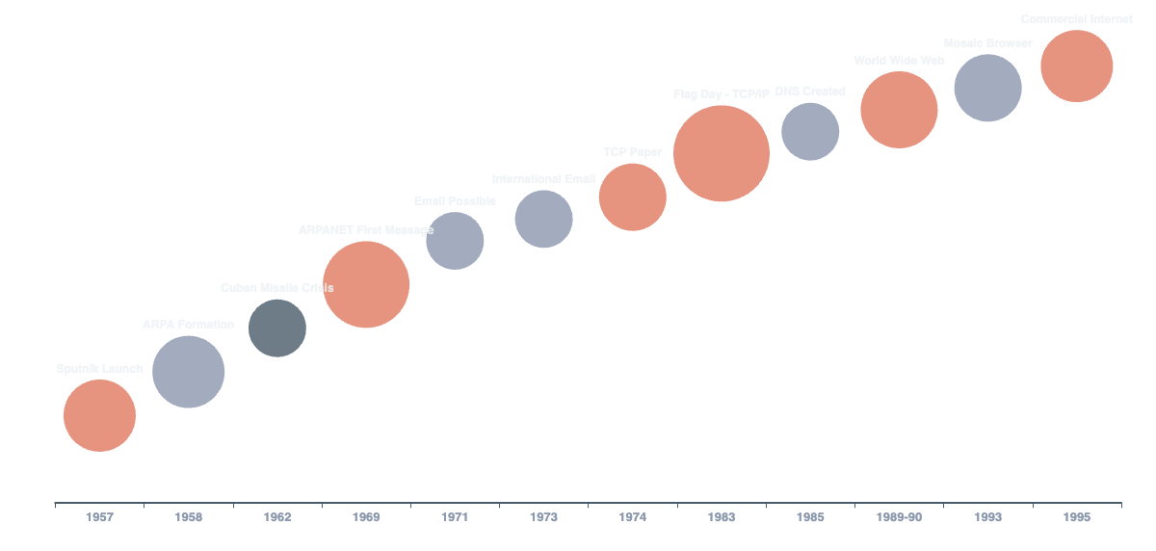
08
Internet Evolution Timeline

Slide 10
09
How the Internet Works
The Postal System Analogy
DNS: The Phone Book
Think of the Internet like a giant postal system for digital data. Every device has a unique address, and data travels in labeled packets through routing "post offices."
Domain Name System (DNS) translates human-friendly domain names (like "google.com") into numerical IP addresses that routers understand.
Key Concept: Data is broken into small "packets" — each labeled with source and destination IP addresses.
Human-Readable
Machine-Readable
google.com
142.250.80.46
The Complete Data Flow Process
TCP/IP in Action
1
Request Initiated
You type a web address or send data
IP (Internet Protocol)
2
DNS Translation
Handles addressing and routing — determines where packets should go using IP addresses
Domain name converted to IP address
3
Packet Creation
TCP (Transmission Control)
Data split into packets with IP labels
Ensures reliable delivery — reassembles packets in correct order, handles errors, manages flow
4
Router Navigation
Packets travel through multiple routers
5
Reassembly & Delivery
TCP reassembles packets in correct order
Packet Switching
Routers
Global Scale
Resilient, dynamic routing
Network traffic directors
Billions of devices connected

Slide 11
10
OSI Model: 7-Layer Architecture
What is OSI?
The 7-Layer Stack (Ailo Preo Sojon Tule Niye Dolonchapa Phul)
The Open Systems Interconnection (OSI) Model is a conceptual framework that organizes network functions into seven distinct layers.
7
Application Layer
HTTP, FTP, SMTP(Simple Mail Transfer Protocol), DNS — User interfaces and network services
6
Presentation Layer
Purpose: Standardize network communication and ensure interoperability between different hardware, software, and protocols.
SSL/TLS,(Secure Sockets Layer / Transport Layer Security)MIME(Multipurpose Internet Mail Extensions) —
Data formatting, encryption, compression
5
Session Layer
NetBIOS, RPC (NetBIOS (Network Basic Input/Output System) Remote Procedure Call,
— Session management and control
Historical Context
4
Transport Layer
Before OSI: Proprietary architectures (IBM's SNA, DECnet) created compatibility issues
TCP, UDP — End-to-end communication and reliability
ISO Solution: Developed in late 1970s, published 1984 as ISO 7498
3
Network Layer
Goal: Universal rules so all devices could communicate
IP, ICMP, Routing — Logical addressing and path determination
ISO 7498:
ISO/IEC 7498,widely known as the OSI (Open Systems Interconnection) model, is a foundational conceptual framework
2
Data Link Layer
Ethernet, Wi-Fi, PPP — Node-to-node data transfer, MAC addressing
1
Physical Layer
Cables, radio signals — Physical transmission of raw bits
Remember: The OSI Model is a reference model, not a protocol suite. TCP/IP is used more in practice, but OSI remains vital for teaching and conceptual clarity.

Slide 12
11
OSI Layers Deep Dive
7
Application
4
Transport
2
Data Link
Closest to end users. Provides network services to applications.
End-to-end communication, reliability, flow control, error checking.
Node-to-node transfer, MAC addressing, error detection on physical layer.
Protocols:
TCP
UDP
Technologies:
HTTP, FTP, SMTP, DNS, Telnet
Reliable, ordered
Fast, no guarantee
Ethernet, Wi-Fi, PPP, VLANs
6
Presentation
Data formatting, encryption, compression. Ensures readability.
1
Physical
Physical transmission of raw bits — cables, signals, connectors, radio waves.
Functions:
3
Network
SSL/TLS, MIME, ASCII/Unicode
Media:
Routing, logical addressing (IP), path determination across networks.
Fiber, twisted pair, Wi-Fi signals
5
Session
Protocols:
IP, ICMP, IPsec, OSPF, BGP
Manages sessions between applications — establishment, maintenance, termination.
Data Encapsulation
Protocols:
Each layer adds its own header information as data moves down the stack — like putting a letter in increasingly larger envelopes.
NetBIOS, RPC, APIs

Slide 13
12
TCP/IP Model Comparison
TCP/IP Model
OSI vs TCP/IP Mapping
De Facto Internet Standard
OSI Layers 5-7
The TCP/IP Model is the practical standard suite of protocols that governs how data moves across the Internet.
Session, Presentation, Application
TCP/IP Layer 4
Application
Development: Created by DARPA in the 1970s, officially adopted January 1, 1983 ("Flag Day")
OSI Layer 4
Transport
TCP/IP Layer 3
Transport
TCP/IP 4-Layer Architecture
OSI Layer 3
Network
4
Application Layer
HTTP, FTP, SMTP, DNS
TCP/IP Layer 2
Internet
3
Transport Layer
OSI Layers 1-2
TCP, UDP
Physical, Data Link
TCP/IP Layer 1
2
Internet Layer
Network Access
IP, ICMP, Routing
1
Network Access
Why TCP/IP Won
Ethernet, Wi-Fi, Physical
Practical Implementation: Actually built and deployed
Government Backing: DARPA funding and support
Simplicity: 4 layers vs 7, easier to implement
Proven Success: Powered ARPANET and early Internet
Key Insight: While TCP/IP is the practical standard used today, the OSI Model remains essential for teaching, troubleshooting, and conceptual understanding of network architecture.

Slide 14

JOURNEY COMPLETE
From "lo" to Global
Connectivity
What began as a defense project with a crashed "login" attempt has evolved into the backbone of global communication.
Layered Architecture
Packet Switching
Standardized Protocols
OSI and TCP/IP models provide structured frameworks for understanding complex network interactions
The revolutionary concept that enables resilient, decentralized communication across global networks
TCP/IP provides the universal language enabling billions of devices to communicate seamlessly
The Internet's Impact: From a military research project to the foundation of modern civilization — connecting people, enabling commerce, accelerating innovation, and transforming how we share knowledge across the planet.
1957 - 2025
68 Years of Innovation
Session 2
Networking Fundamentals

